Slide 1

Chapter 2
Leader Development
© McGraw-Hill Education. All rights reserved. Authorized only for instructor use in the classroom. No reproduction or further distribution permitted without the prior written consent of McGraw-Hill Education.

Slide 2
Chapter Outline
Introduction
The action, observation, and reflection model
The key role of perception in the spiral of experience
Reflection and leadership development
Making the most of your leadership experiences: learning to learn from experience
Building your own leadership self-image

Slide 3
Leader Development
Leadership and learning are indispensable to each other
John F. Kennedy

Slide 4
The Action, Observation, and Reflection Model
Shows that leadership development is enhanced when the experience involves the following processes:
Action
Observation
Reflection
Spiral of experience
Most productive way to develop as a leader

Slide 5
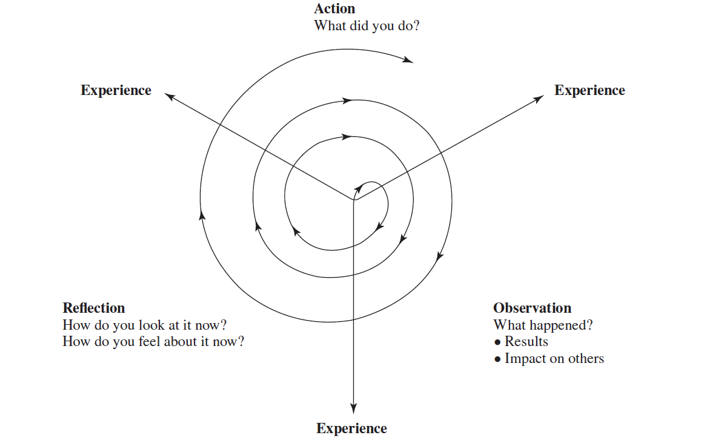
Figure 2.1: The Spiral of Experience
Jump to Figure 2.1: The Spiral of Experience, Appendix

Slide 6
Key Role of Perception in the Spiral of Experience
Experience depends on what events happen to one and how one perceives those events
Perception affects all three phases of the action, observation, and reflection or A O R model
People actively shape and construct their experiences

Slide 7
Perception and Observation
Observation and perception both deal with attending to events around a person
People are selective in what they attend to and what they perceive
Perceptual sets can influence any of one’s senses
Tendency or bias to perceive one thing and not another
Feelings, needs, prior experiences, and expectations can all trigger a perceptual set
Stereotypes about gender, race, and the like represent powerful impediments to learning because they function as filters that distort one’s observations

Slide 8
Perception and Reflection, 1
Perception influences reflection
Reflection is how humans interpret their observations
Perception is inherently an interpretive, or a meaning-making, activity, of which attribution is an important aspect
Attributions: Explanations that one develops for the characteristics, behaviors, or actions he or she attends to
Factors that affect the attribution process
Fundamental attribution error: Tendency to overestimate the dispositional causes of behavior and underestimate the environmental causes when others fail

Slide 9
Perception and Reflection, 2
Self-serving bias: Tendency to make external attributions for one’s own failures and make internal attributions for one’s own successes
Actor or observer difference: Refers to the fact that people who are observing an action are much more likely than the actor to make the fundamental attribution error
Apart from perception and attribution, reflection also involves higher functions like evaluation and judgment

Slide 10
Perception and Action
Research shows that perceptions and biases affect supervisors’ actions toward poorly performing subordinates
Self-fulfilling prophecy is a perceptual variable that can affect actions
Self-fulfilling prophecy: Occurs when one's expectations or predictions play a causal role in bringing about the events he or she predicts
  Having expectations about others can subtly influence our actions, and these actions can, in turn, affect the way others behave

Slide 11
Reflection and Leadership Development
Reflection offers leaders insights about framing problems differently, viewing situations from multiple perspectives, and understanding subordinates better
Leaders tend to ignore reflection because they lack time or they lack awareness of its value
Leadership development can be enhanced by raising implicit beliefs to conscious awareness in order to aid thoughtful reflection
Intentional reflection may prompt one to see potential benefits in experience not initially considered relevant to leadership

Slide 12
Fundamental Archetypes of Leadership
Teacher and mentor
Father and judge
Warrior and knight
Revolutionary and crusader
Visionary and alchemist

Slide 13
Single- and Double-Loop Learning
Single-loop learners seek relatively little feedback that may significantly confront their fundamental ideas or actions
Individuals learn only about subjects within the comfort zone of their belief systems
Double-loop learning involves being willing to confront one’s own views and inviting others to do the same
Mastering double-loop learning is viewed as learning how to learn
Learning is enhanced through a practice of systematic reflection or after event reviews or A E Rs

Slide 14
Making the Most of One's Leadership Experiences: Learning to Learn from Experience
Learning events and developmental experiences that punctuate one’s life are stressful
Being able to go against the grain of one’s personal historical success requires a strong commitment to learning and a willingness to let go of the fear of failure and the unknown
To be successful, learning must continue throughout life and beyond the completion of one’s formal education

Slide 15
Leader Development in College, 1
Programs on leadership studies are being offered by many higher education institutions and colleges
Leadership programs should be multidisciplinary and should cultivate values represented in the broader field
Service learning is used to inculcate values such as social responsibility and the expectation to become engaged in one’s community
Should focus on expected developmental outcomes, with associated assessment and evaluation to determine program effectiveness

Slide 16
Leader Development in College, 2
Different leader development methods may be used beyond service learning
Some courses or program elements might involve individualized feedback to students in the form of:
  Personality, intelligence, values, or interest test scores
  Leadership behavior ratings
Case studies and role playing are used as vehicles for leadership discussions
Simulations and games are structured activities designed to mirror the challenges or decisions commonly faced in the work environment

Slide 17
Leader Development in Organizational Settings, 1
Organization-based leadership programs benefit both the individual and the organization
Research indicates that return on investment or R O I for investments used in leadership development are both positive and substantial
Numerous leadership training programs are aimed at leaders and supervisors in industry and public service

Slide 18
Leader Development in Organizational Settings, 2
Program content depends on the organization level of participants
First-level supervisors
Mid-level managers

Slide 19
Leader Development in Organizational Settings, 2
Programs for first-level supervisors use lectures, case studies, and role-playing exercises to improve supervisory skills
Focus on:
  Training
  Monitoring
  Giving feedback
  Conducting performance reviews

Slide 20
Leader Development in Organizational Settings, 3
Mid-level manager programs use individualized feedback, case studies, presentations, role playing, simulations, and in-basket exercises to improve:
Interpersonal skills
Oral and written communication skills
Time management
Planning
Goal setting

Slide 21
Leader Development in Organizational Settings, 4
Conger states that a multi-tiered approach is effective and should focus on personal growth, skill building, feedback, and conceptual awareness
Some approaches to leadership development emphasize individualized feedback about each person’s strengths and weaknesses based on standardized assessment methods
Others emphasize that leader development in the twenty-first century must occur in more lifelike situations and contexts
Leadership programs for senior executives and C E Os focus on strategic planning, public relations, and interpersonal skills

Slide 22
Training Programs and Action Learning
Traditional training programs involve personnel taking leadership classes during work hours
Such training addresses common leadership issues, but its artificial nature makes it difficult to transfer concepts to actual work situations
Action learning involves the use of actual work issues and challenges as the developmental activity itself
Works on the philosophy that best learning involves learning by doing
Conducted in teams of work colleagues who are addressing real company challenges

Slide 23
Development Planning, 1
To make enduring behavioral changes, leaders must provide positive answers to the following five questions:
Do leaders know which of their behaviors need to change?
Is the leader motivated to change these behaviors?
Do leaders have plans in place for changing targeted behaviors?
Do leaders have opportunities to practice new skills?
Are leaders held accountable for changing targeted behaviors?

Slide 24
Development Planning, 2
Good development plans are constantly being revised as new skills are learned or new opportunities to develop skills become available
Provides a methodology for leaders to improve their behavior even as they go about their daily work activities

Slide 25
Coaching, 1
Key leadership skill that can help leaders improve the bench strength of the group and retain high-quality followers
Process of equipping people with the tools, knowledge, and opportunities that they need to develop and become more successful
Types of coaching
Informal coaching: Takes place whenever a leader helps followers to change their behaviors
Formal coaching programs: Designed for the specific needs and goals of individual executives and managers in leadership positions

Slide 26
Peterson and Hicks: Steps in Informal Coaching
Forging a partnership
Inspiring commitment
Growing skills
Promoting persistence
Shaping the environment

Slide 27
Informal Coaching
Process can be used to diagnose why behavioral change is not occurring and what can be done about it
Can and does occur anywhere in the organization and is effective for both high-performing and low-performing followers
Increases in difficulty when it occurs either remotely or across cultures

Slide 28
Features of Formal Coaching, 1
One-on-one relationship between manager and coach lasts from six months to more than a year
Process begins with an assessment of the manager to clarify development needs
Coach and manager meet regularly to build skills
Role plays and videotape are used extensively, and coaches provide immediate feedback
Outcomes of coaching programs
  Clarification of managers’ values
  Identification of discrepancies between managers’ espoused values and their actual behaviors
  Development of strategies to better align managers’ behaviors with their values

Slide 29
Features of Formal Coaching, 2
Formal coaching programs can cost more than 100,000 dollars
Coaching may be more effective at changing behavior than more traditional learning and training approaches

Slide 30
Mentoring, 1
Personal relationship in which a more experienced mentor acts as a guide, role model, and sponsor of a less experienced protégé
Mentor: Experienced person willing to take an individual under his or her wing
  Usually someone 2 to 4 levels higher in an organization
  Provides protégés with knowledge, advice, challenge, counsel, and support about career opportunities, organizational strategy and policy, and office politics

Slide 31
Mentoring, 2
Not the same as coaching because:
It may not target specific development needs
Guidance is provided by someone several leadership levels higher in the organization and not the immediate supervisor
Mentor may not even be part of the organization
There are formal and informal mentoring programs
Informal mentoring occurs when a protégé and mentor build a long-term relationship based on friendship, similar interests, and mutual respect

Slide 32
Mentoring, 3
In a formal mentoring program, the organization assigns a relatively inexperienced but high-potential leader to a top executive in the company
  Often used to accelerate the development of female or minority protégés
Informal mentoring may be more effective than formal mentoring as it creates a stronger emotional bond and can last a lifetime

Slide 33
Building One's Own Leadership Self-Image
Not everyone wants to be a leader or believes he or she can be
Many people are selling themselves short
People who want to avoid the responsibilities of leadership should keep an open mind about the importance and pervasiveness of leadership

Slide 34
Summary
One way to add value to one's leadership courses and experiences is by applying the action, observation, and reflection model
To become a better leader, one must seek challenges and try to make the best of any leadership opportunity
Behavior change efforts are most successful if some formal system or process of behavioral change is put into place
Systems include action learning, development planning, informal and formal coaching programs, and mentorships
Leaders can help their followers with behavioral change through coaching or mentoring programs

Slide 35
APPENDIX

Slide 36
Figure 2.1: The Spiral of Experience, Appendix
The spiral begins at the center and moves outward. Three arrows originate from the center and point outward to the top-left, top-right, and bottom portions of the exhibit. All three arrows are labeled experience. The content on the top of the spiral reads action: what did you do? The content on the bottom-left side of the spiral reads reflection: how do you look at it now? And how do you feel about it now? The content on the bottom-right side of the spiral is labeled observation: what happened? results and impact on others.
Jump back to Figure 2.1: The Spiral of Experience

